Slide 1

Web Development and Database Project – Horizon Hotels
Fiorella Scarpino
ID: 21010043

Slide 2
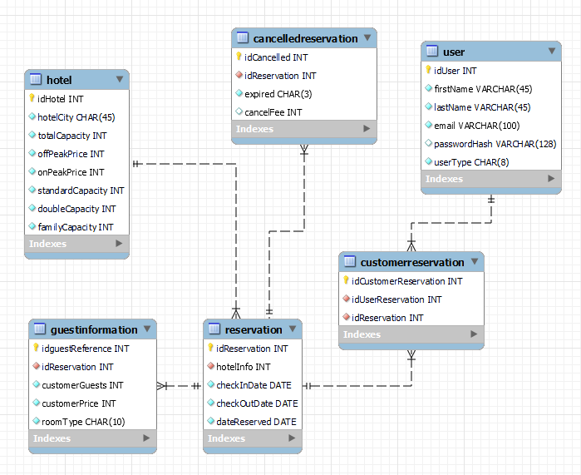
Database Design

Slide 3
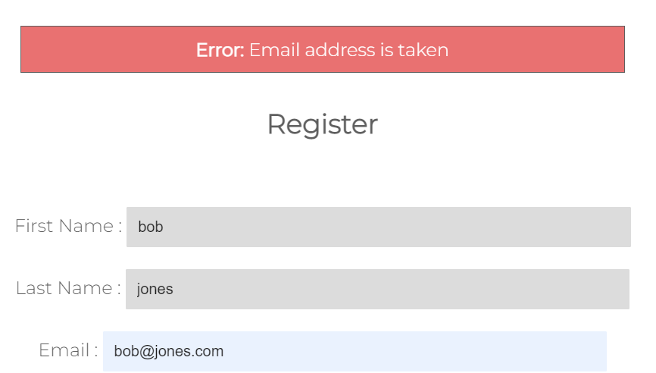
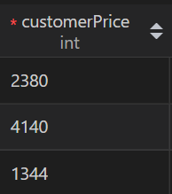
Database Explained
1st Normal Form: The database is in 1NF as there are no multi-valued attributes, they are atomic, not repeating and columns have unique names.
2nd Normal Form: The database is in 2NF as it is in 1NF and there are no partial dependencies, I used foreign keys to get rid of any dependencies, each table is unique and there is no redundant data.
3rd Normal Form: The database is in 3NF as it is in 2NF and there are no transitive functional dependencies, only the primary key determines the whole row.
The database has its own validation, every table has a primary key and the datatypes I selected are relevant to the data being stored, for example the hashed password element will only accept a varchar that is 128 characters long, dates are stored in the date format %Y-%m-%d and prices are in decimal. And the tables and columns have suitable names.

Slide 4
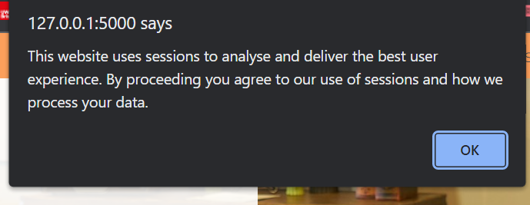
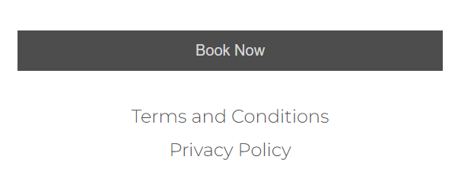
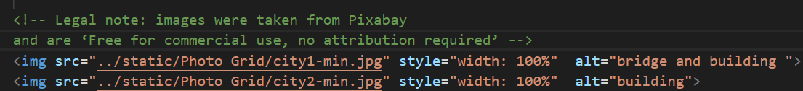
Legal and Ethical Issues
I created a thorough terms & conditions and privacy policy document. It covers the main points of the Data Protection Act, the UK GDPR, the data Horizon Hotels stores and processes and any business process, such as cancellation fees, prices and occupancy. I have done this to make the process of booking and navigating the website as transparent as possible for the users.
The user passwords are encrypted and hashed in the database, I used sha256_crypt to encrypt the password. The hashed passwords are then added to the database where each element will only allow a varchar of 128 characters, this ensures that no extra, potentially harmful data is stored in the database. I also created a Flask secret key to keep the client-side sessions secure.
All the images I used on the website are from Pixabay. Pixabay state that their images are ‘Free for commercial use, no attribution required’. I created the logo for Horizon Hotels so there are no trademark issues. All images used on the website have a legal note stating where the images came from and their royalty status.
I did not use cookies, instead the website uses sessions to track the user for the duration of their stay at the website. Once the user has logged off the website, their data is ‘popped’ off, meaning that the website is no longer storing and tracking any potentially sensitive data. Sessions are a vital part of the website and the user is made aware of their data being processed through pop ups and terms & conditions and privacy policy documents that the user can read at any time.
User data is not shared to any 3rd parties, all the data that a user submits stays in the horizon hotel website and database until they log off or delete their account.

Slide 5
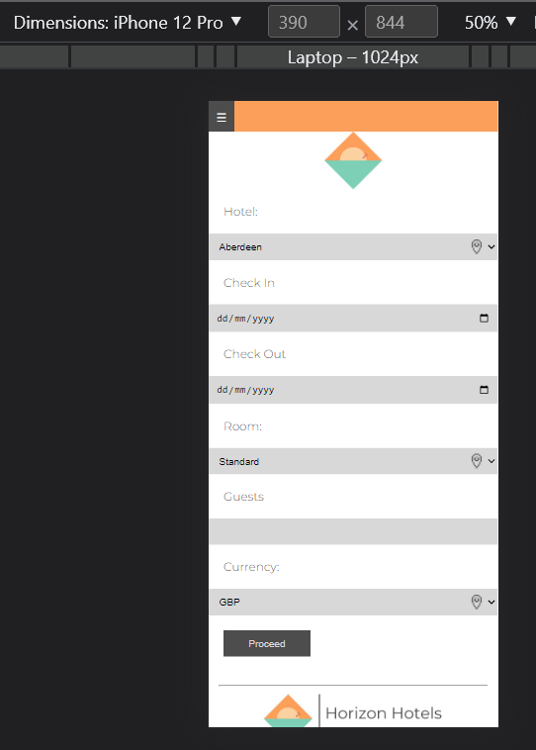
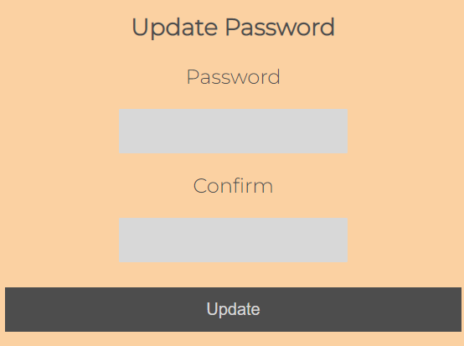
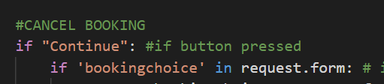
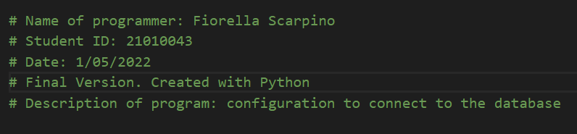
Social and Professional Issues
The website has alternative text on every image for screen readers, there are no flashing elements or videos. There are no pop ups that are on a timer, so there is plenty of time to read the messages as they won’t disappear. There is only a plain background behind elements so it legible. The buttons are a different colour to the form inputs to make it easier to distinguish. There are some gradual animations, however they do not flash or interrupt the rest of the page. The website layout is predictable and sensibly labeled to avoid confusion. Headers are in bold and table columns are clearly labeled. Every page is responsive to the device size, so it can adjust to any assistive devices or smaller/larger screens, using Flexbox to fit pages to 3 different viewpoints; Desktop, Tablet and Smartphone breakpoints.
The website has gone through well-known coding and documentation practices. Before programming, I looked at the functional and non-functional aspects and planned the website layout. Then created the GUI and Database design. And the website has been though a testing process. There are comments in the code and at the start of every piece of code there is a description of who wrote the code and what its for

Slide 6
Testing
I carried out black and white box testing. Black box testing was carried out by putting valid and invalid data into forms, not checking radio boxes and putting the wrong data into fields. All invalid data is taken care of either through popup messages and error messages I created, redirecting or refreshing pages. If a user tries to book or access their homepage and admin homepage without being logged in, they will be redirected. This is to ensure there is no unauthorized access to any part of the website.
White box testing was carried out while programming. I would print values and data into the terminal to check what was being stored. This made it easier to error check and do validation on the data. I also made sure to check how the data was being inputted and store in the database.

Slide 7
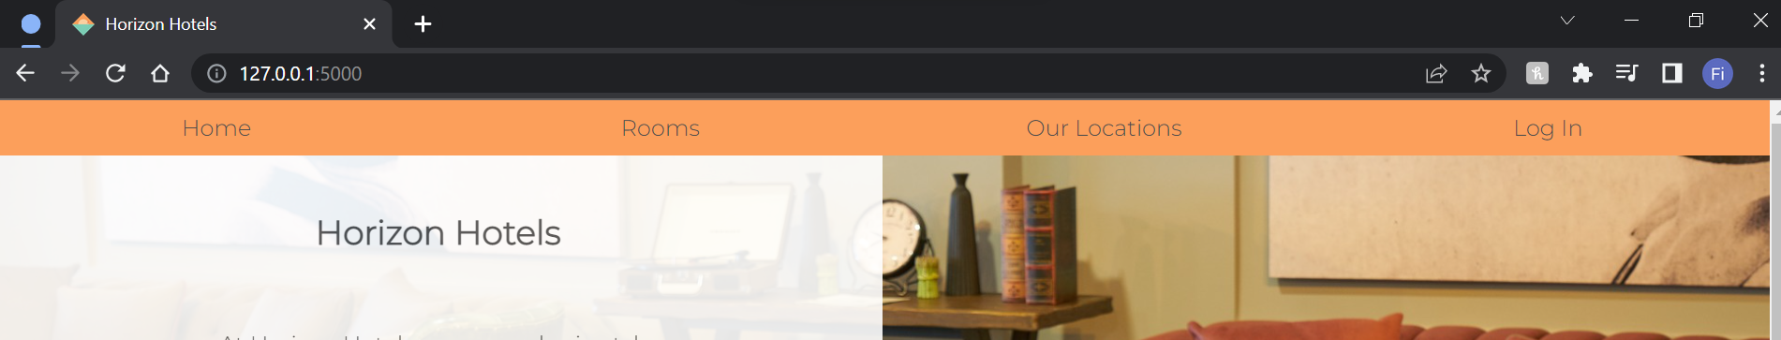
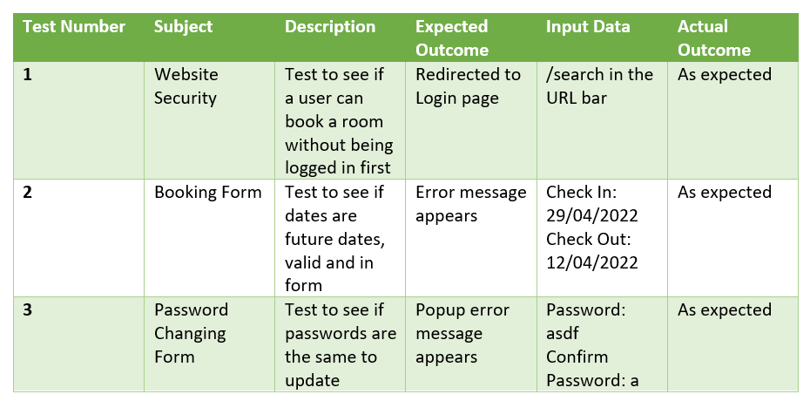
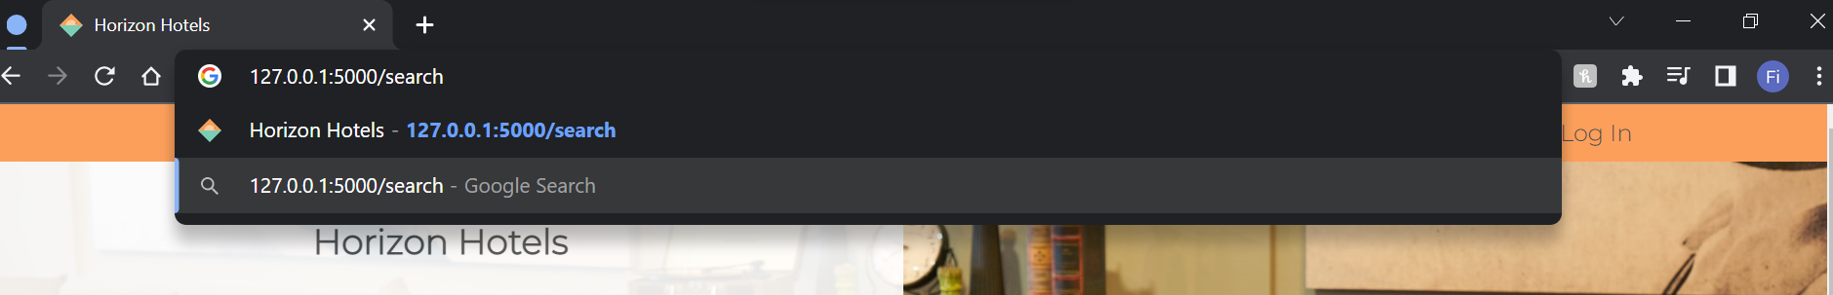
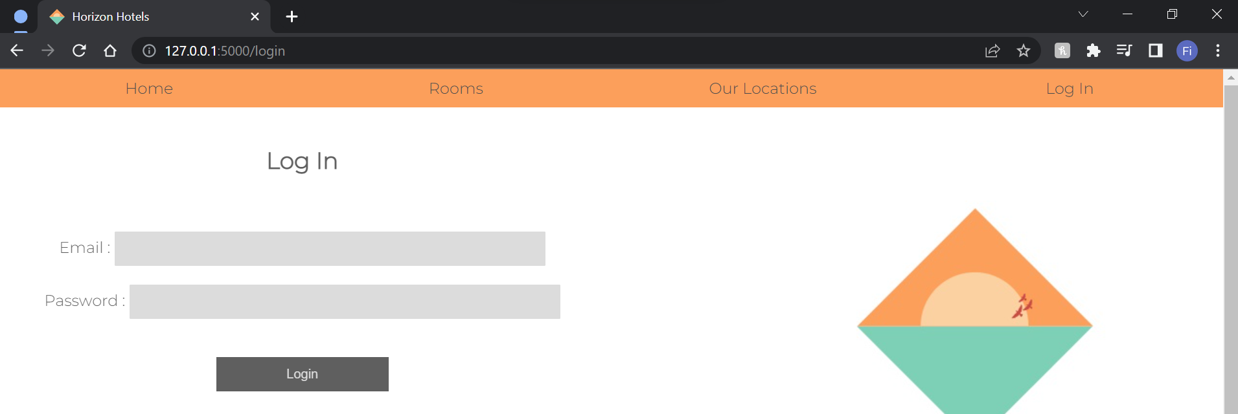
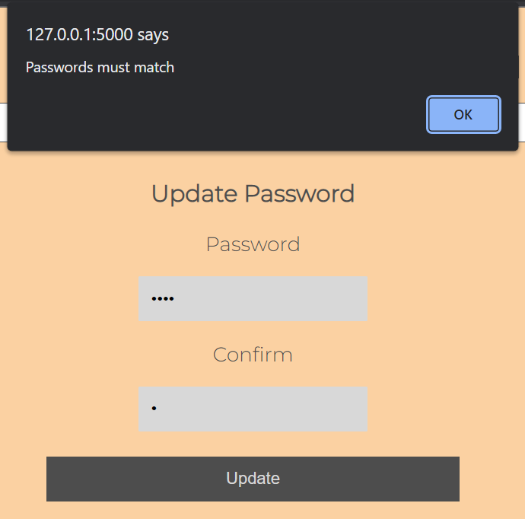
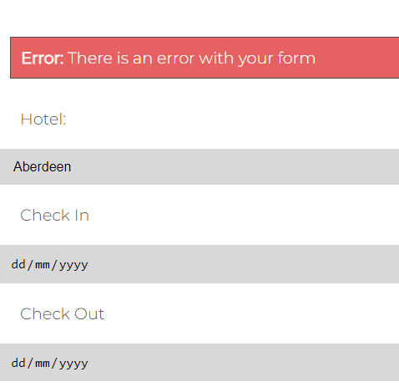
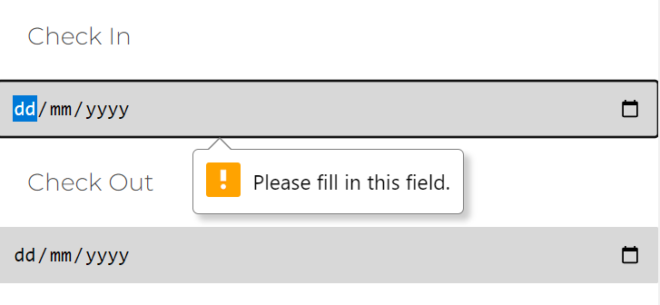
Testing

Slide 8
Evaluation
I believe my website meets the requirements. The entire website is responsive on 3 different screen sizes. I think the website looks clean and functional with some extra design ideas, like tooltips and image collages. The user can change passwords, see all bookings and cancel a booking. The admin can see all bookings, add a hotel, change hotel capacities and view charts for total bookings each month. There is business logic, cancellation fees, advanced booking discounts and the option to pay in EUR, USD and GBP. The website has static and dynamic pages, such as privacy and T’s & C’s. There are screen messages and pop ups throughout, validation on all forms, sessions to track user. However, if I had more time some areas could be made more efficient but overall the website solves the problem.
My website doesn’t store plaintext passwords, instead it hashes user passwords and stores the hashes in the database, there is authorization validation to make sure the user is only able to access pages that they have permission to, using the built in flask security features. Sessions are used to validate the user and are popped when the user logs out so that any sensitive information isn’t accessible. I have thought about any attempted SQL injections and reduced the risk of that happening in my website.

Slide 9
Thank you

